Slide 1
Dimensionality Reduction
Slides and notes retrieved from “Hands-On Unsupervised Learning Using Python” by Ankur A. Patel. Additionally, some images were retrieved from StatQuest

Slide 2
Dimensionality Reduction
“The curse of dimensionality”
Algorithms cannot effectively train on the data because of the huge size of the feature space
The object is to convert high-dimensional data into a low-dimensional space, with keeping as much of the salient information as possible while removing redundant information.
ML algorithms are able to identify interesting patterns more effectively and efficiently because a lot of the noise has been reduced.

Slide 3
Dimensionality Reduction
Linear Projection vs. Manifold Learning
Linear Projection → involves linearly projecting data from a high-dimensional space to a low-dimensional space.
Principal Component Analysis (PCA)
Singular Value Decomposition (SVD)
Random Projection
Manifold Learning (Nonlinear Dimensionality Reduction) → involves techniques such as isomap, which learns the curved distance (also called the geodesic distance) between points rather than the Euclidean distance.
Multidimensional Scaling (MDS)
Locally Linear Embedding (LLE)
T-distributed Stochastic Neighbor Embedding (t-SNE)
Dictionary Learning
Random Trees Embedding

Slide 4
Principal Component Analysis (PCA)
PCA finds a low-dimensional representation of the data while retaining as much of the variation (i.e., salient information) as possible.
It focuses the correlation among the features.
It will attempt to combine the highly correlated features and represent this data with a smaller number of linearly uncorrelated features.
PCA finds the directions of maximum variance in the original high-dimensional data and projecting them onto a smaller dimensional space.
These newly derived components are known as principal components.

Slide 5
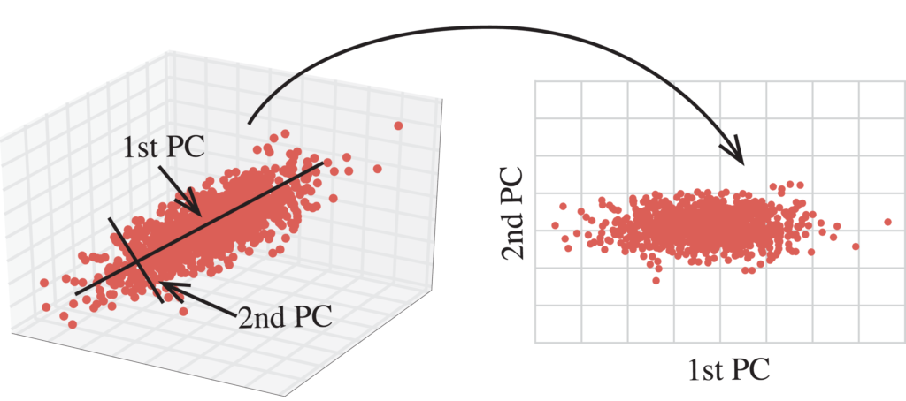
Principal Component Analysis (PCA)

Slide 6
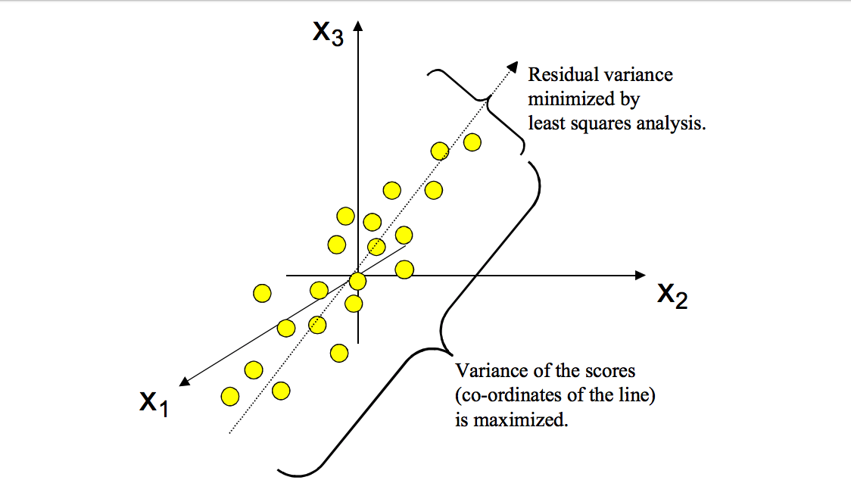
Principal Component Analysis (PCA)

Slide 7
PCA - Important Note
It is essential to perform feature scaling before running PCA.
PCA is very sensitive to the relative ranges of the original features. Generally we must scale the data to make sure the features are in the same relative range.
A model that is trained on a PCA-reduced feature set may not perform quite as well in terms of accuracy as a model that is trained on the full feature set.
But both the training and prediction times will be much faster. This is one of the important trade-offs you must consider.

Slide 8
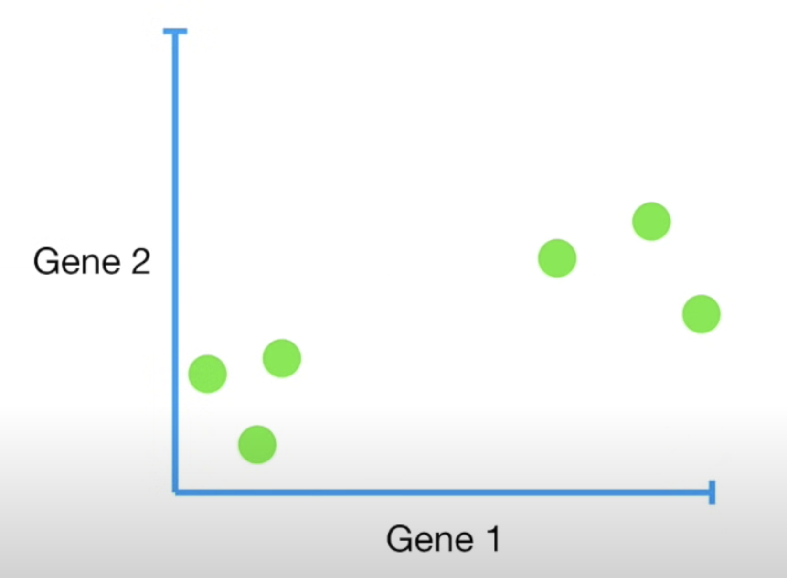
PCA - Details
Assume that we have the following dataset
 | Gene1 | Gene2
Mouse1 | 10 | 6
Mouse2 | 11 | 4
Mouse3 | 8 | 5
Mouse4 | 3 | 3
Mouse5 | 2 | 2.8
Mouse6 | 1 | 1

Slide 9
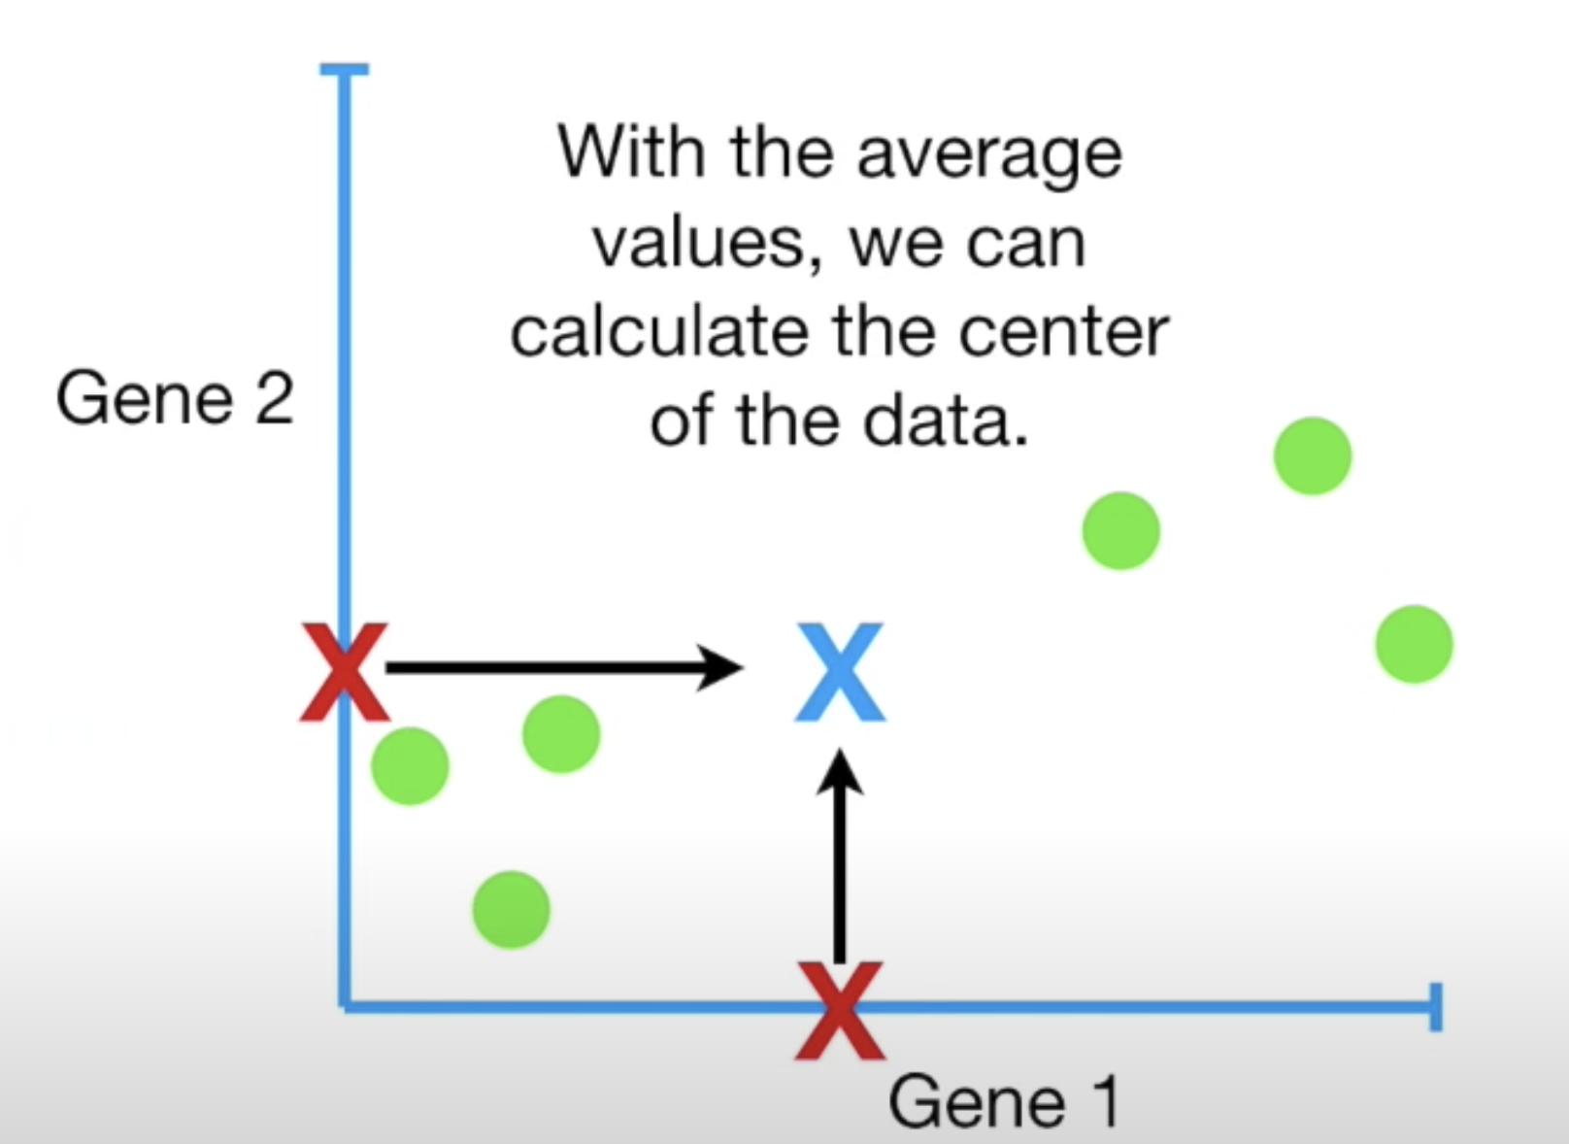
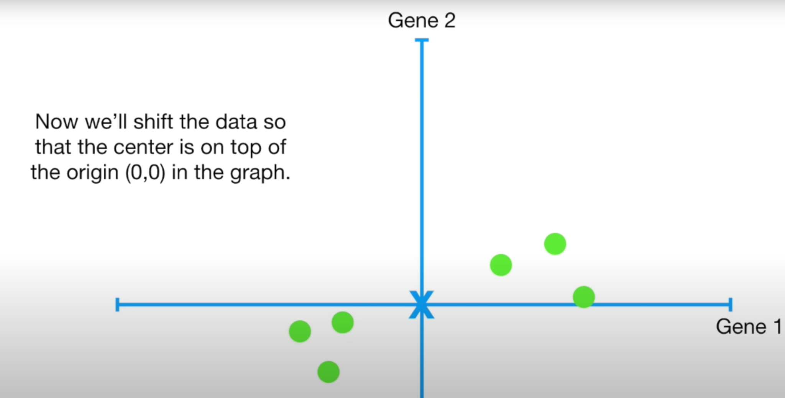
PCA - Details
Then, we need to calculate the average value of each feature, and center of the data.
In the following image (on the left), the red x points are the average values of the features, and the blue x is the average of the data.
Note that shifting operation does not change the relative position of the points.

Slide 10
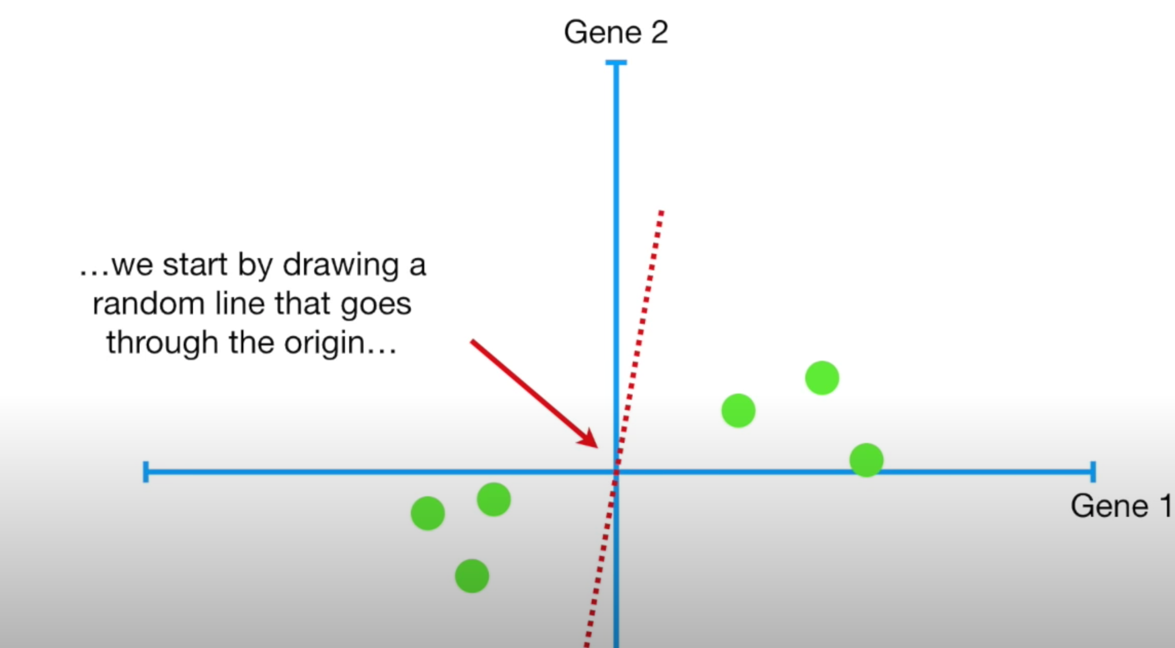
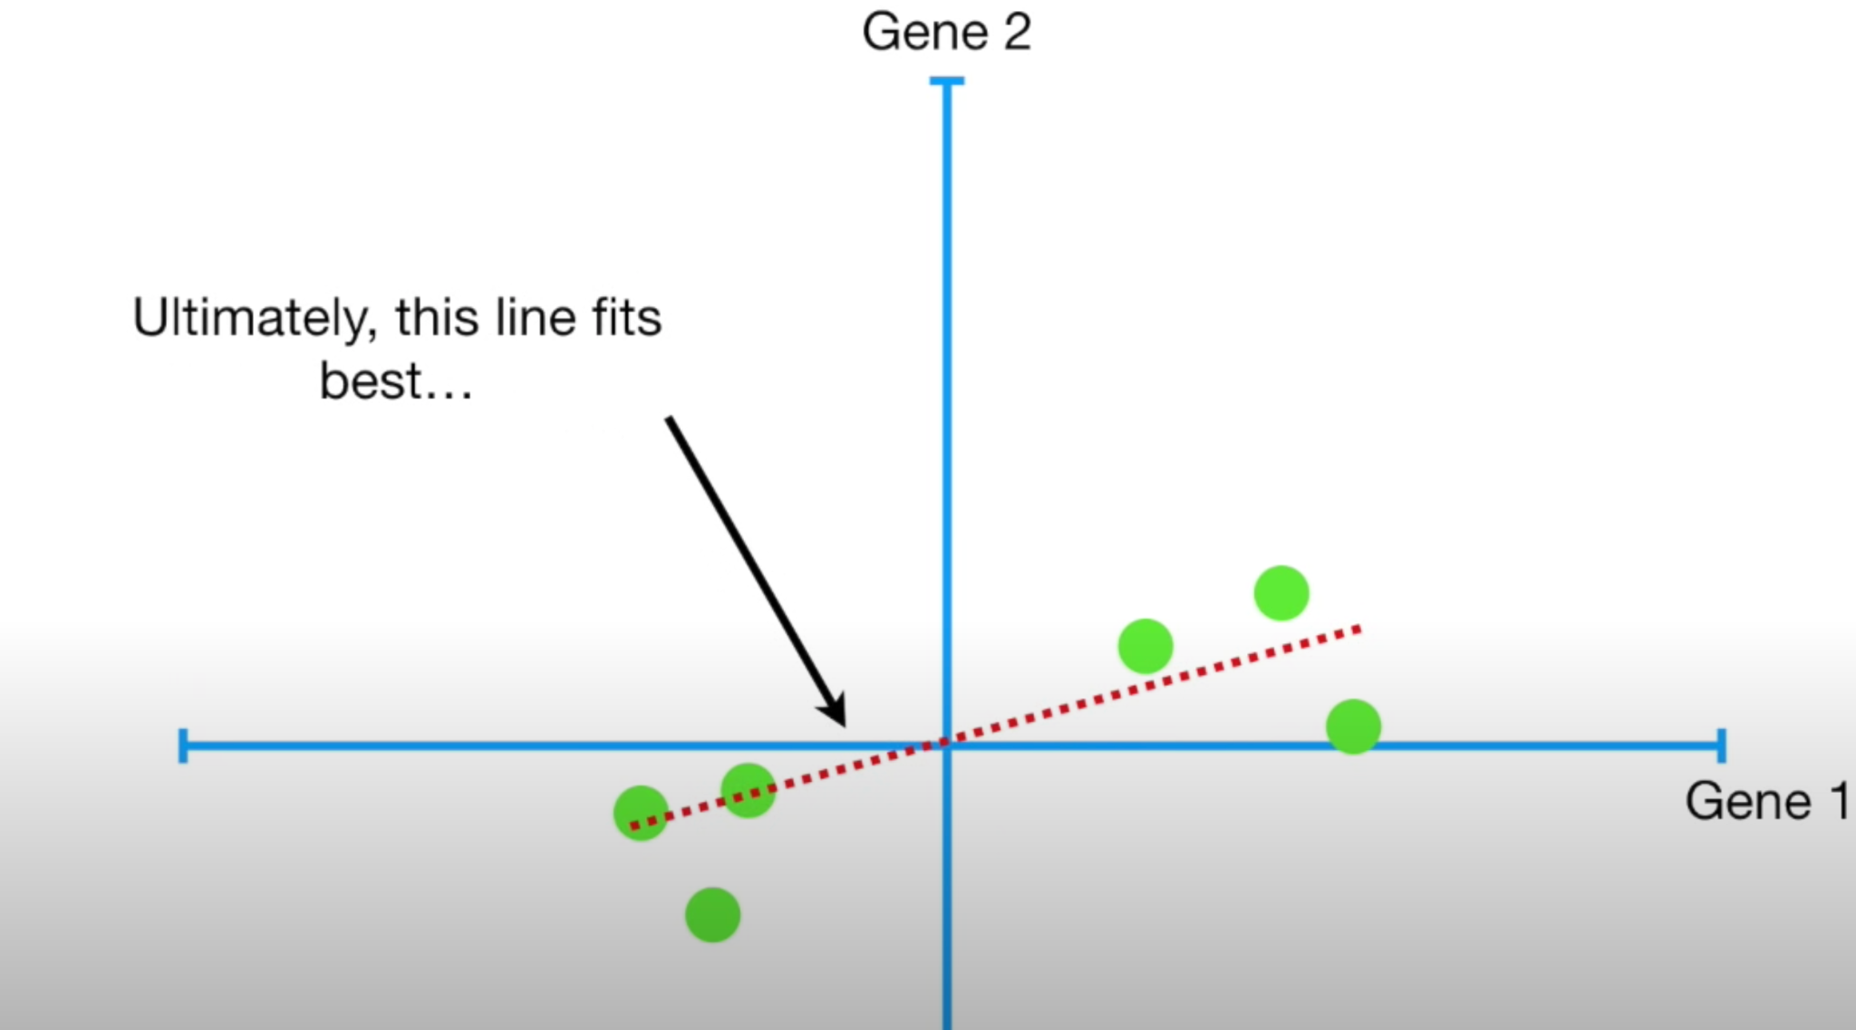
PCA - Details
Let’s draw a random line through the origin, and then rotate it until the best line.

Slide 11
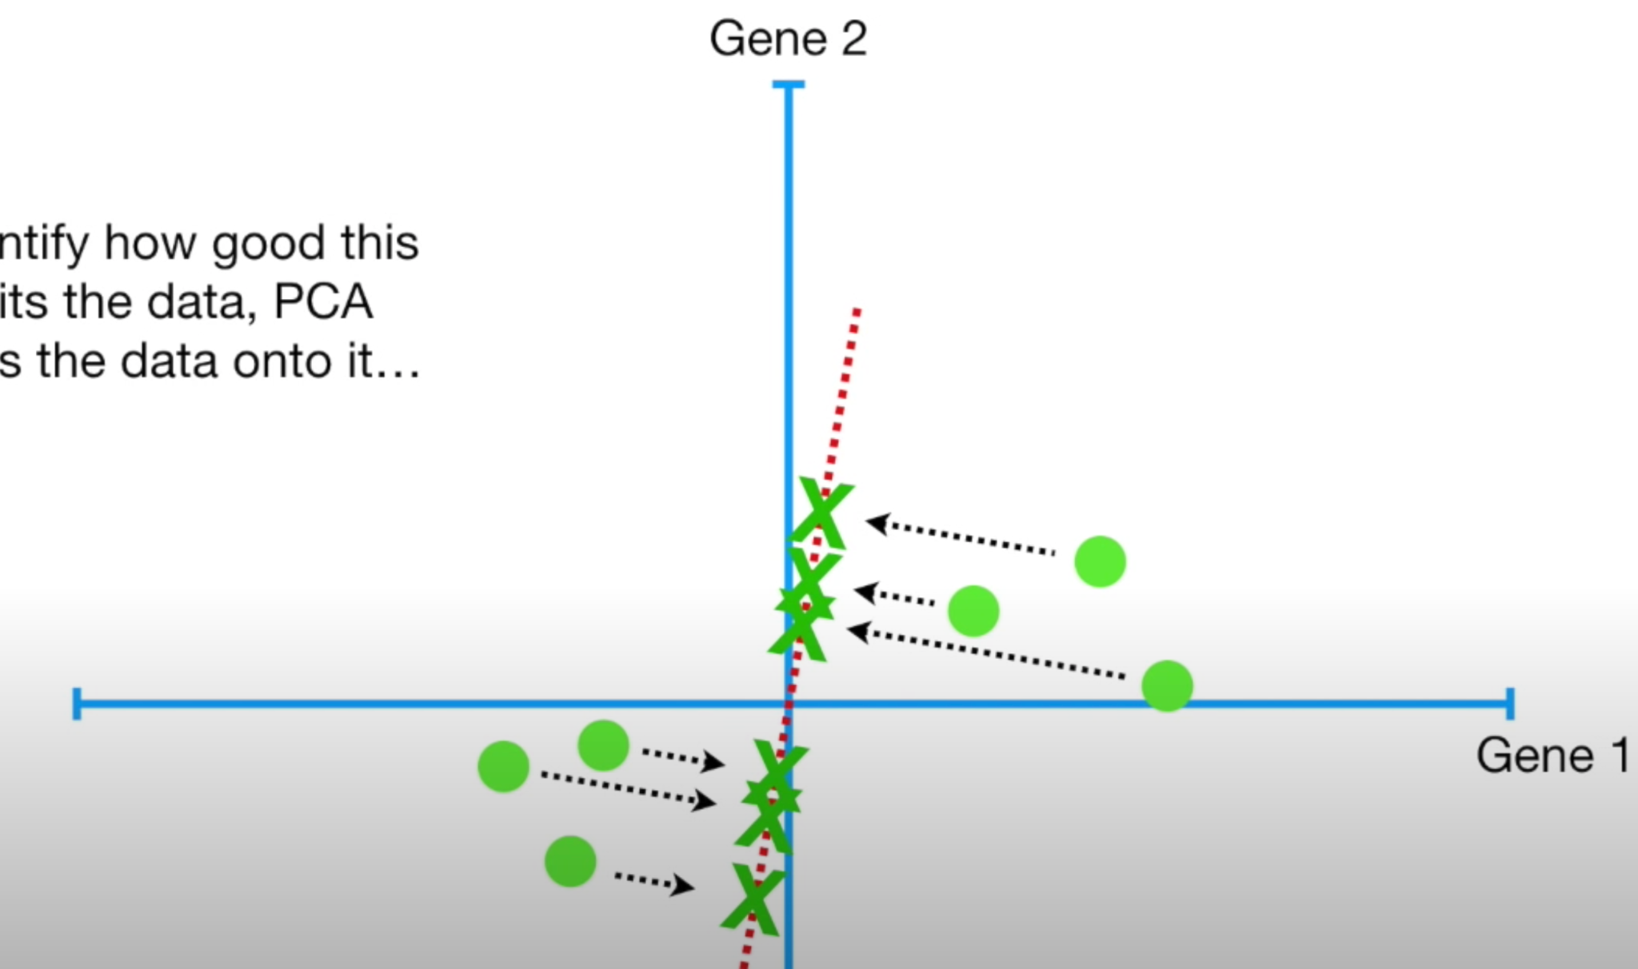

PCA - Details
So, what is the best line? How can we (PCA) decide whether a line is best?
It will either
try to minimize the distance between the points and the line (black dashed arrows) or
try to maximize the distances between the origin and the projection of the points on the line (green x points). Actually, it’s maximizing the variance.

Slide 12
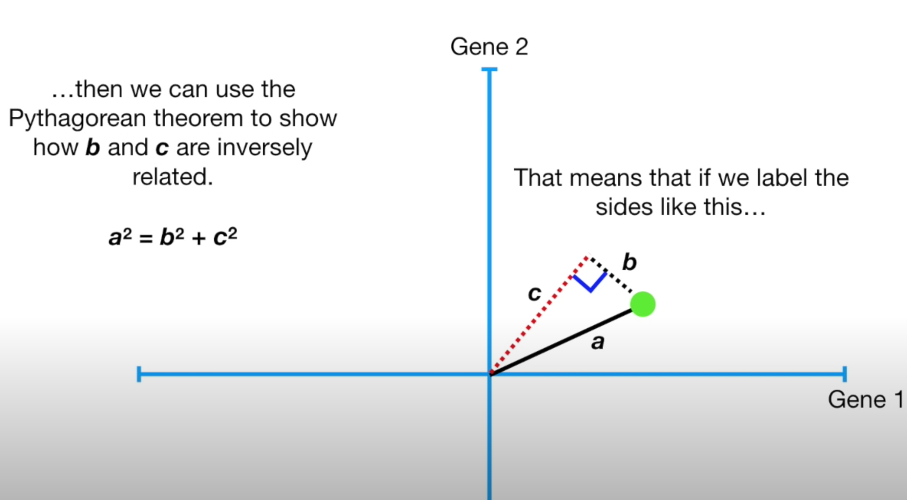

PCA - Details
Actually, both options are the same process.
As you may notice, a will always same. As long as we have "a" closer line to the point, then "b" will get smaller, and "c" will get greater (pythagoras' theorem).

Slide 13
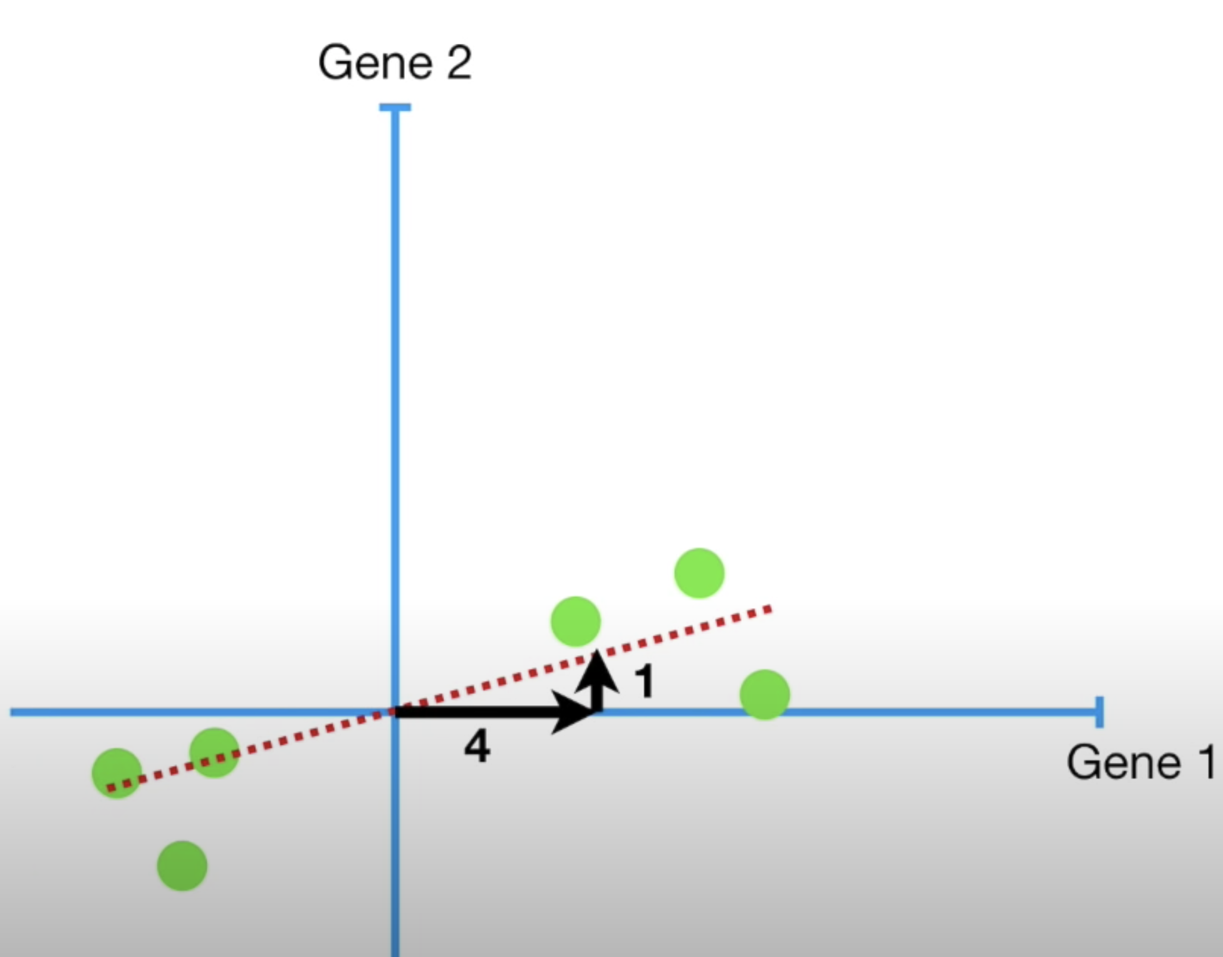
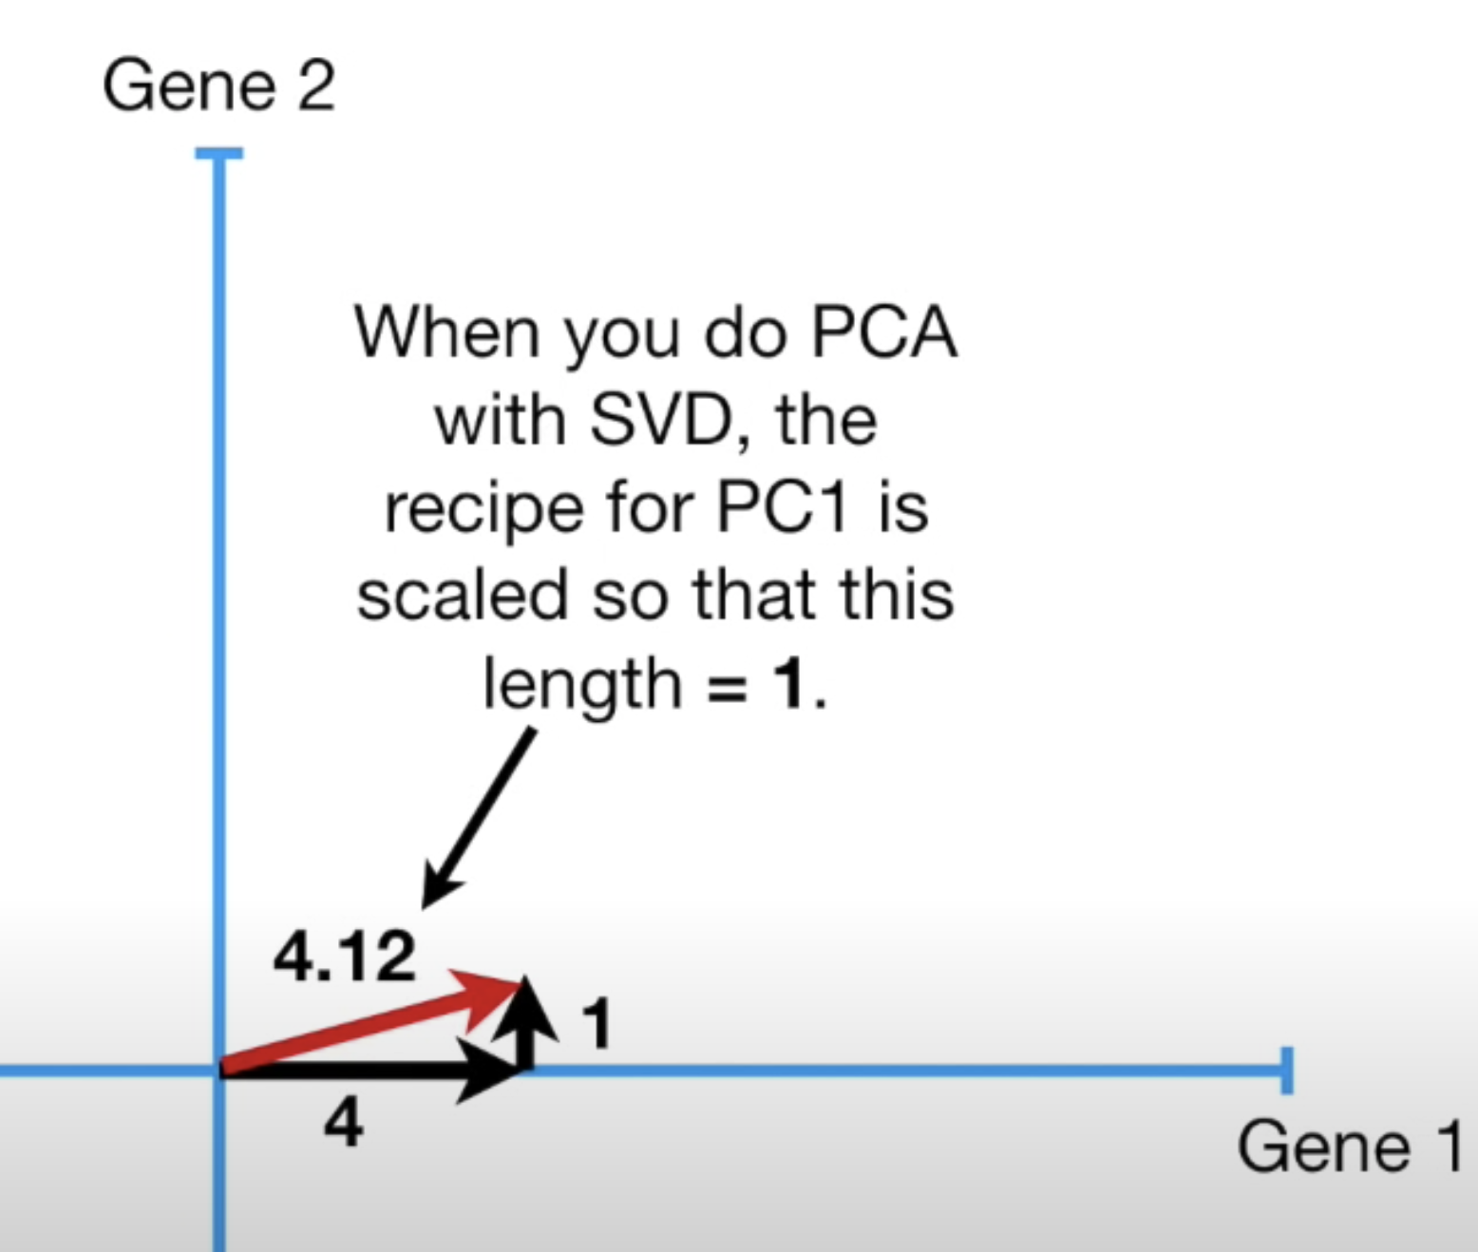
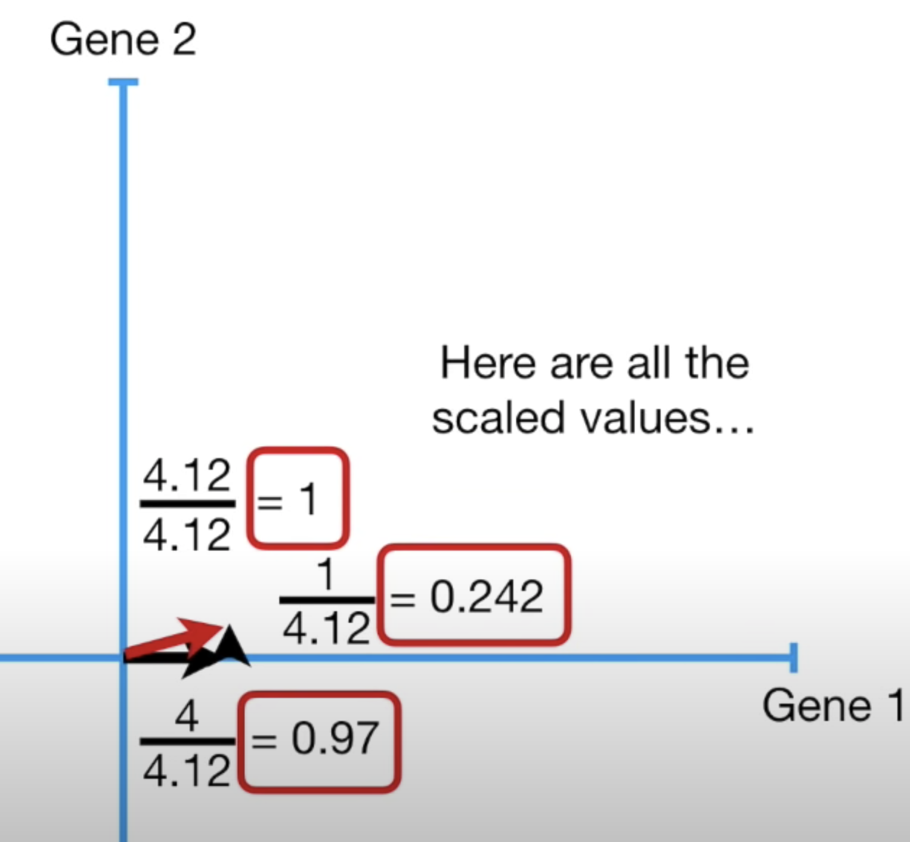
PCA - Details
And, this is the best fitting line based on sum of squared distances between the projections and the origin. It’s called as PC1 (1st Principal Component). The slope of the line (PC1) is 0.25 which means that Gene1 is more important (4 times) than Gene2. In other words, PC1 is linear combination of variables.
In order to compose PC1, we use 0.97 parts of Gene1 and 0.242 parts of Gene2 (the ratio is still same, 4).

Slide 14
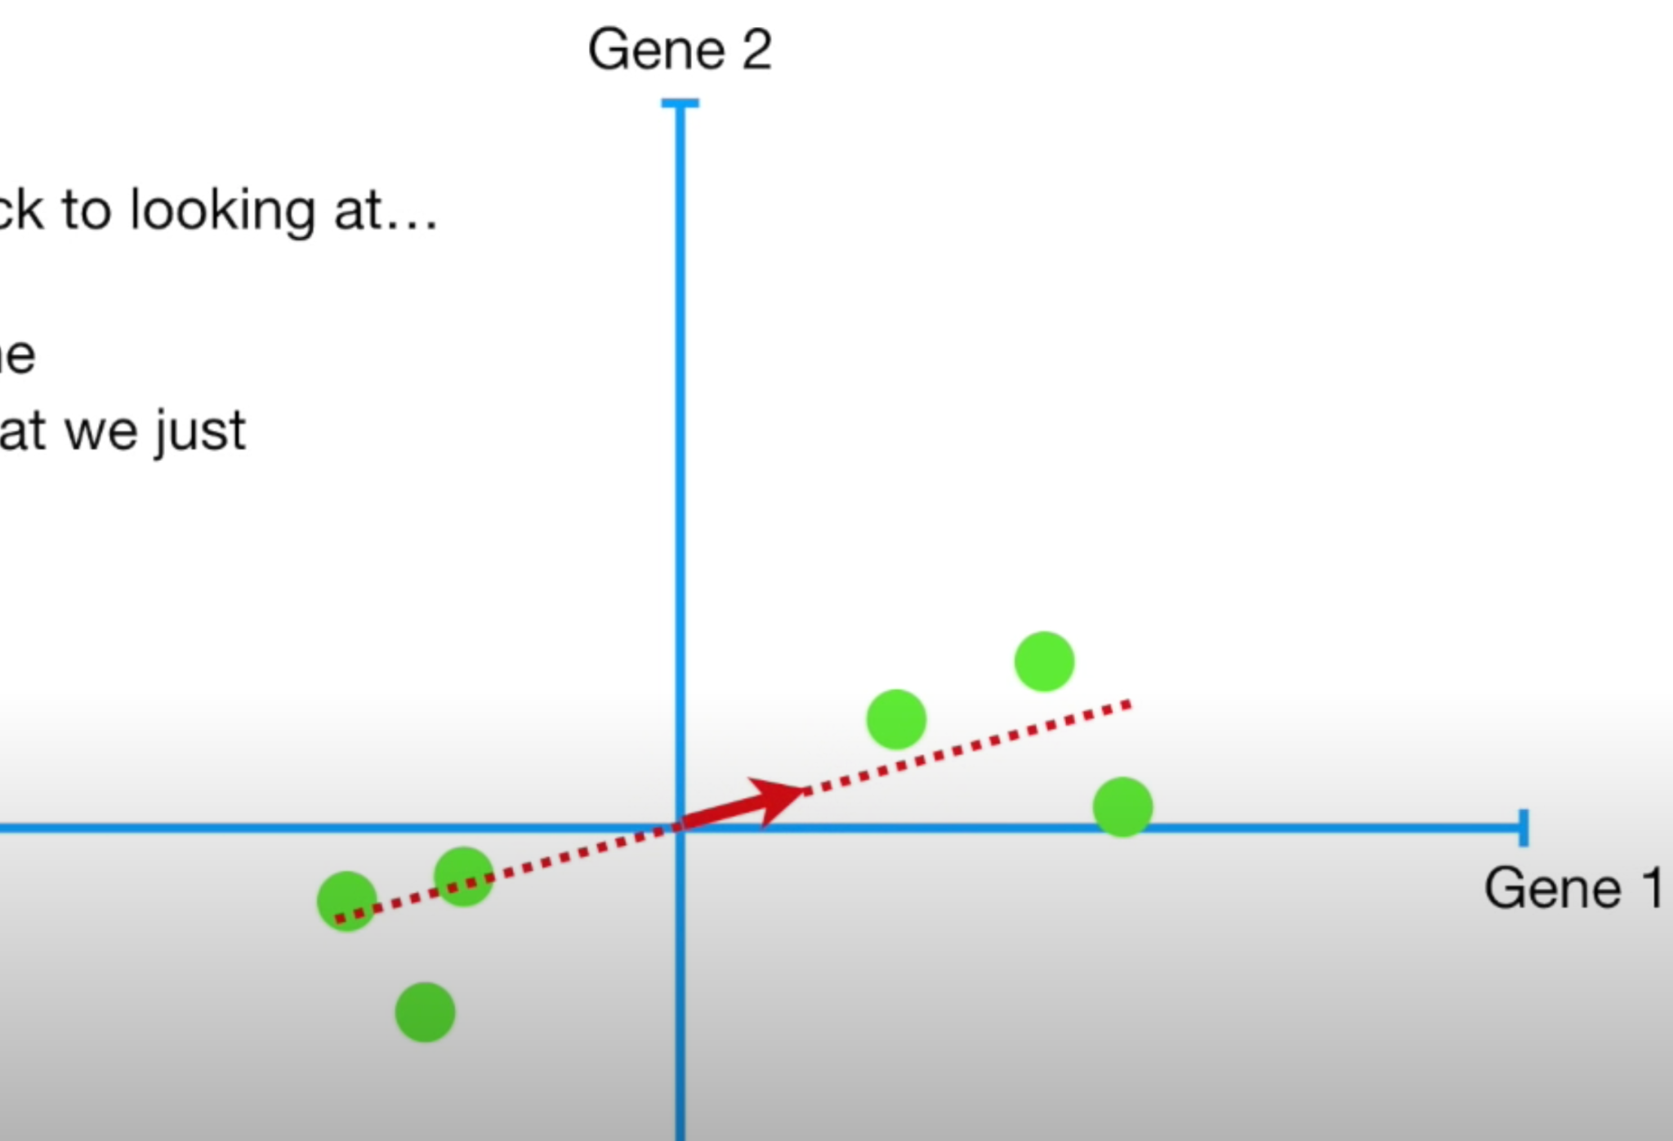
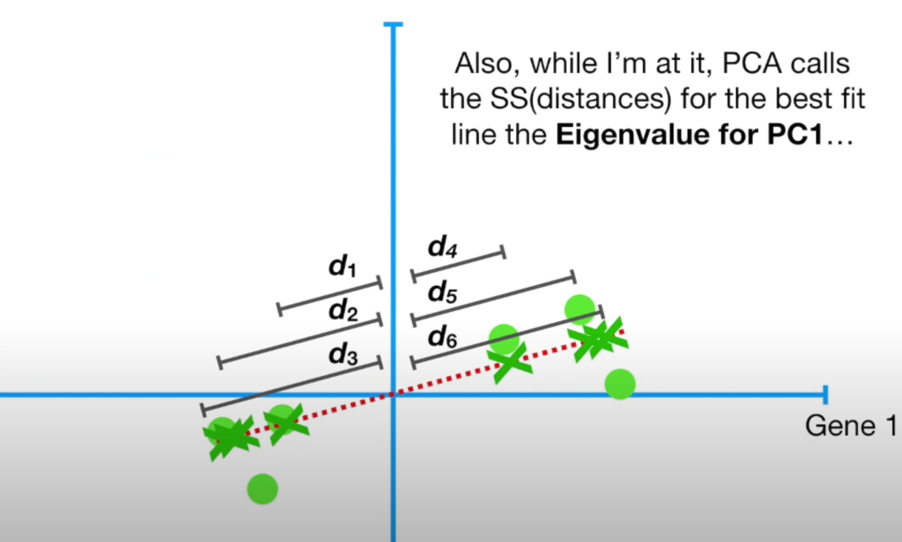

PCA - Details
This 1 unit red vector is called as Eigenvector for PC1.
The sum of squared distances on the best fitted line (d₁²+d₂²+d₃²+d₄²+d₅²+d₆²) is called as Eigenvalue for PC1. The square root of the Eigenvalue is known as Singular Value of PC1.

Slide 15
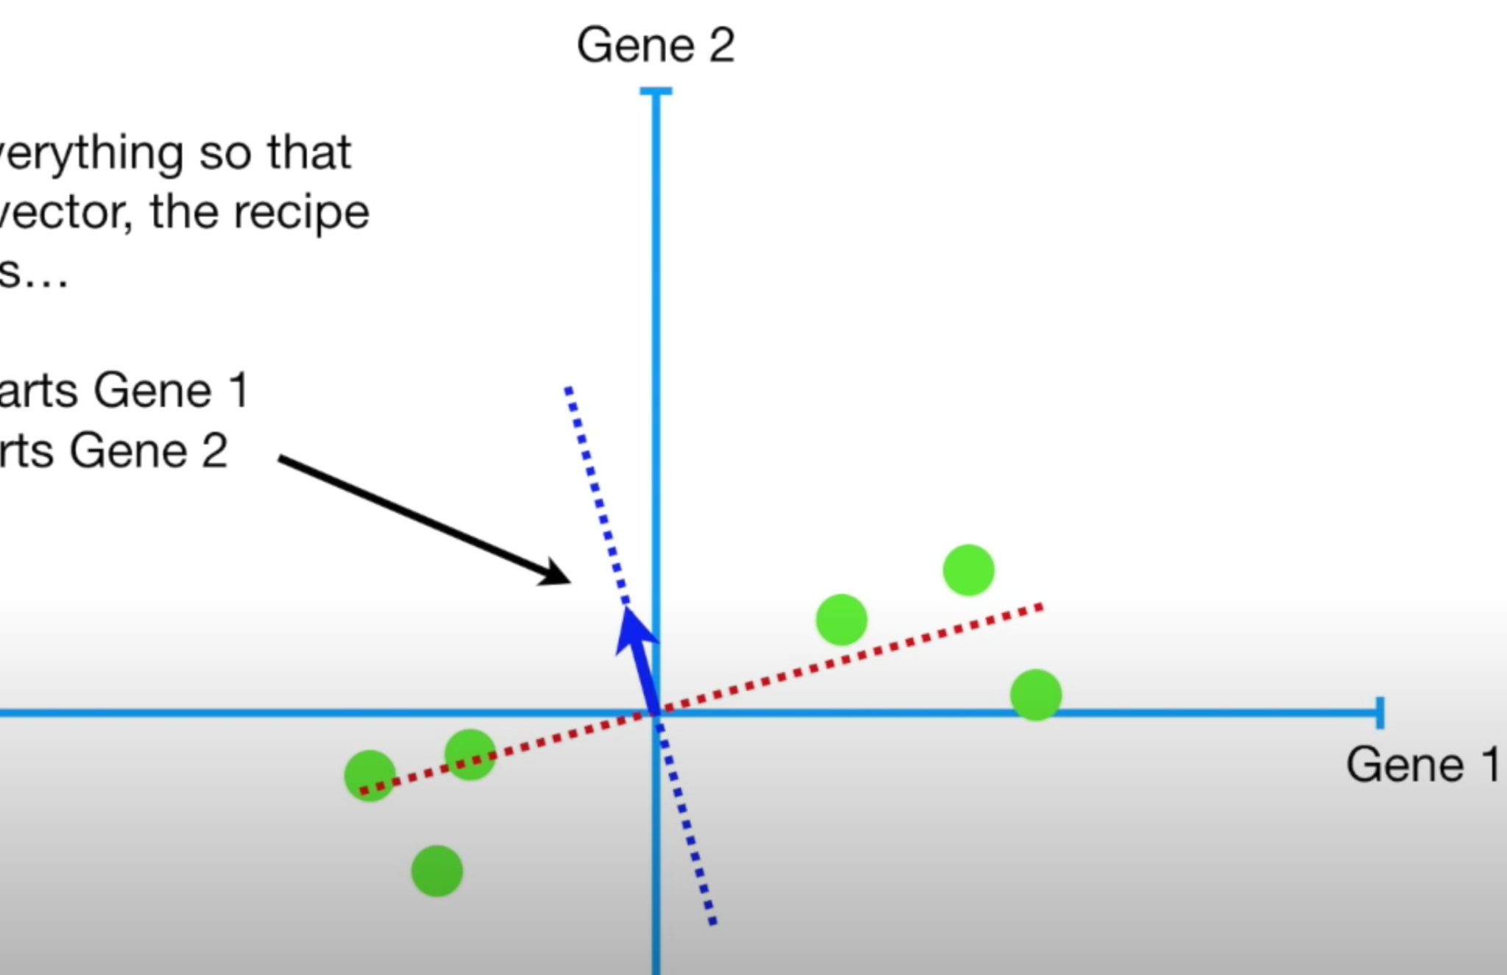

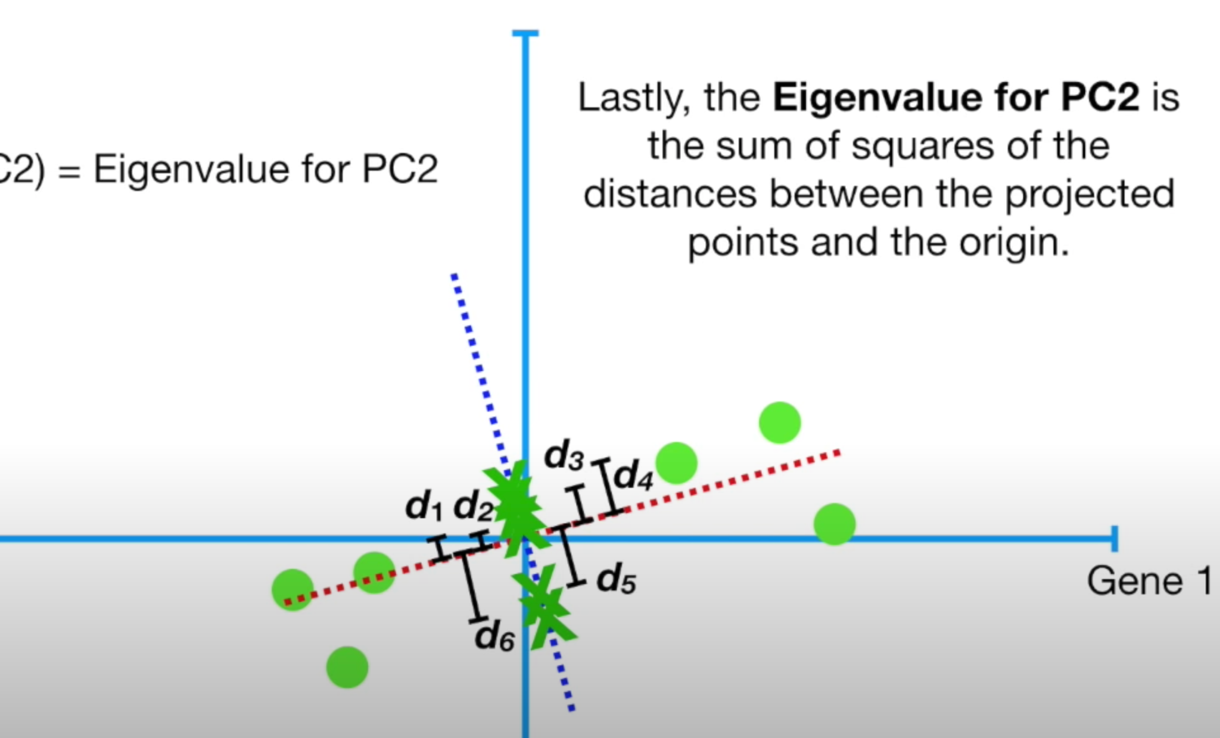

PCA - Details
PC2 must be the line through the origin which is perpendicular to PC1. Since we just have 2 dimensions, PC2 will not need further optimization. -0.242 parts of Gene1 and 0.97 Parts of Gene2 were used to compose PC2.
Eigenvalue of PC2 will again be d₁²+d₂²+d₃²+d₄²+d₅²+d₆²

Slide 16
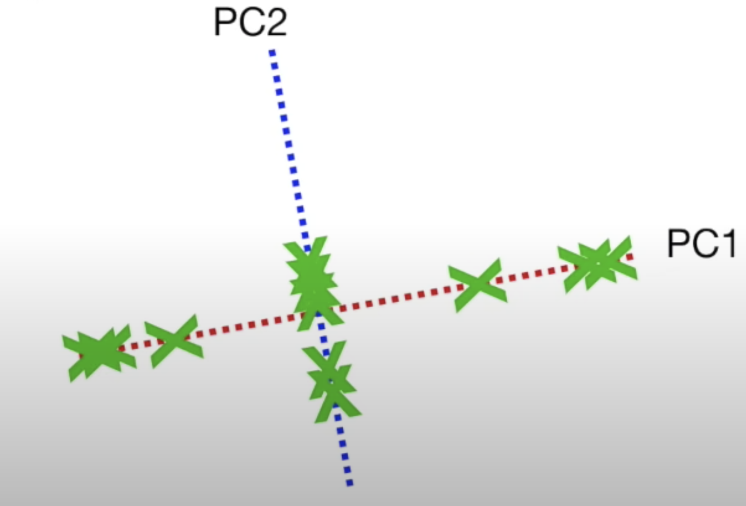
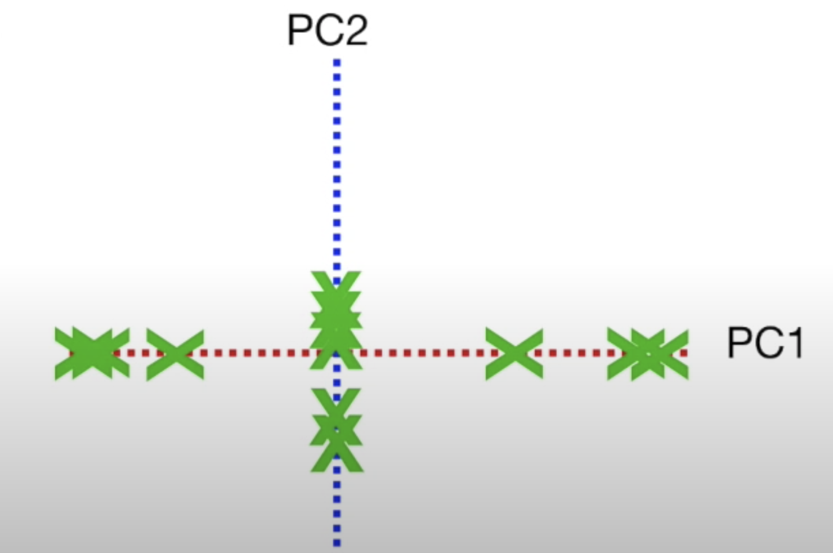
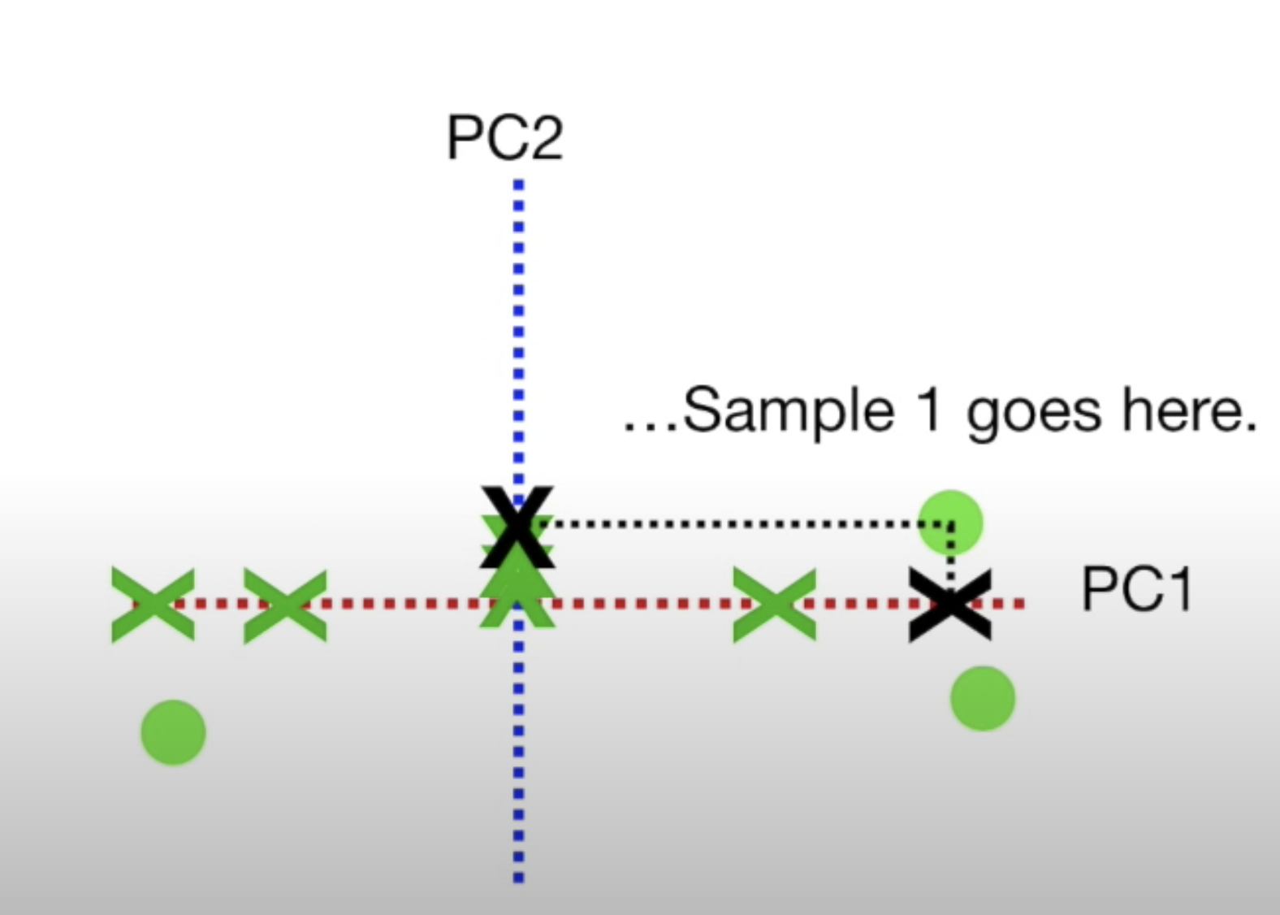
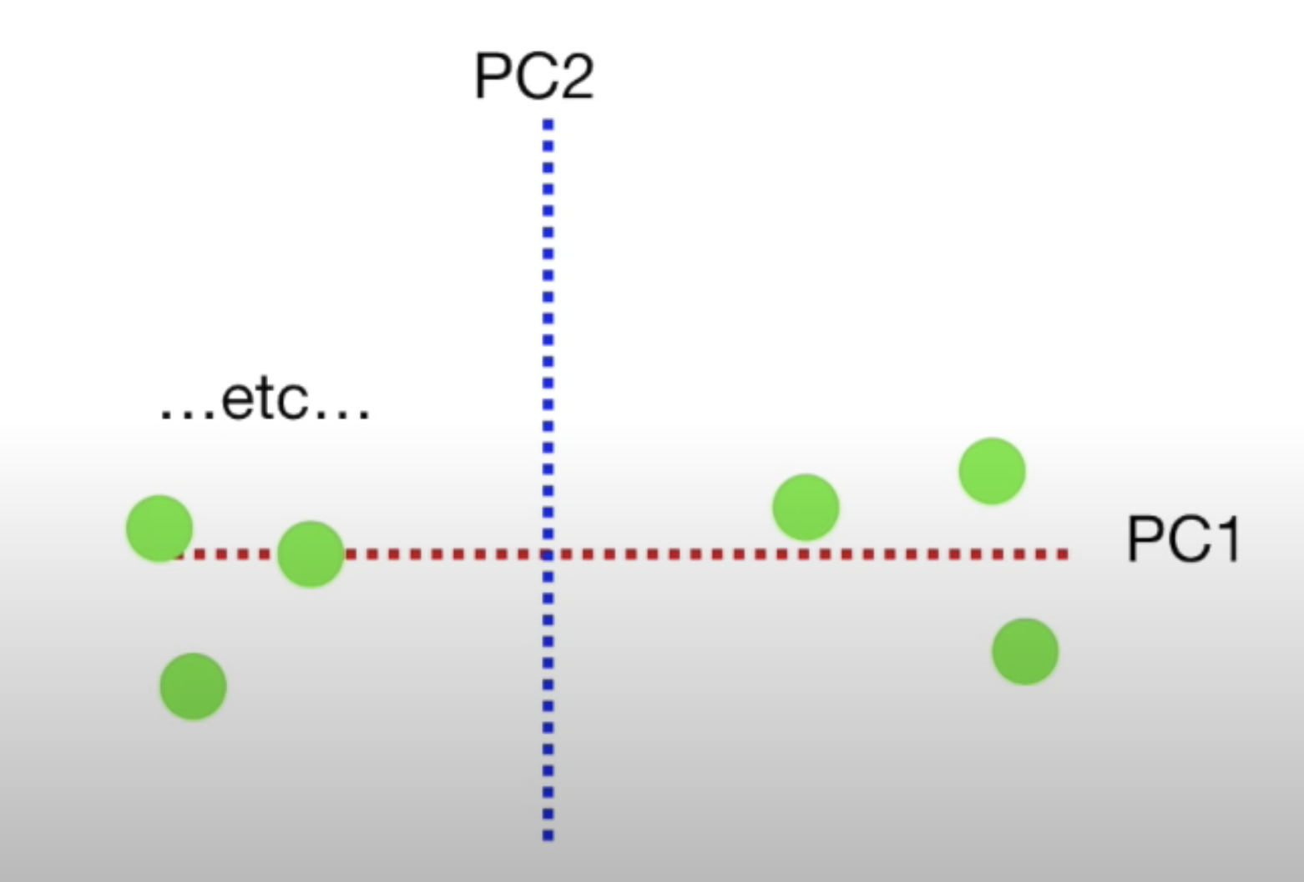
PCA - Details
In order to draw the final PCA plot, we rotate the chart so PC1 will be horizontal.
Then, we use the intersection of projected points on principal components to see the sample locations.

Slide 17
PCA - Details
How can we calculate the variations for each principal component?
Variation_for_PC1 = Eigenvalue_for_PC1 / (n-1)
Variation_for_PC2 = Eigenvalue_for_PC2 / (n-1) where n is the sample size.
If Variation_for_PC1 is 15, and Variation_for_PC2 is 3; then PC1 holds 15/18 = 83% of the total variation.

Slide 18
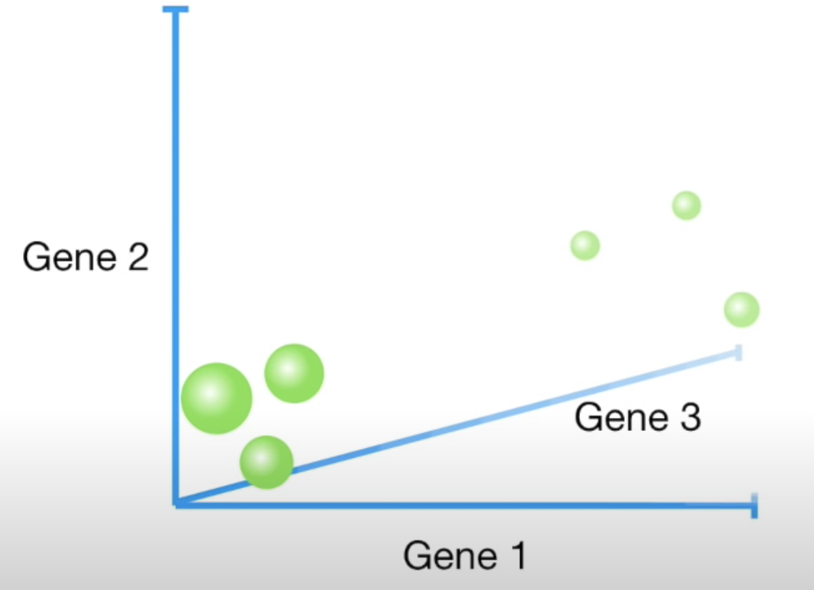
PCA - Details
What about when we have higher number of features?
 | Gene1 | Gene2 | Gene3
Mouse1 | 10 | 6 | 12
Mouse2 | 11 | 4 | 9
Mouse3 | 8 | 5 | 10
Mouse4 | 3 | 3 | 2.5
Mouse5 | 2 | 2.8 | 1.3
Mouse6 | 1 | 1 | 2

Slide 19
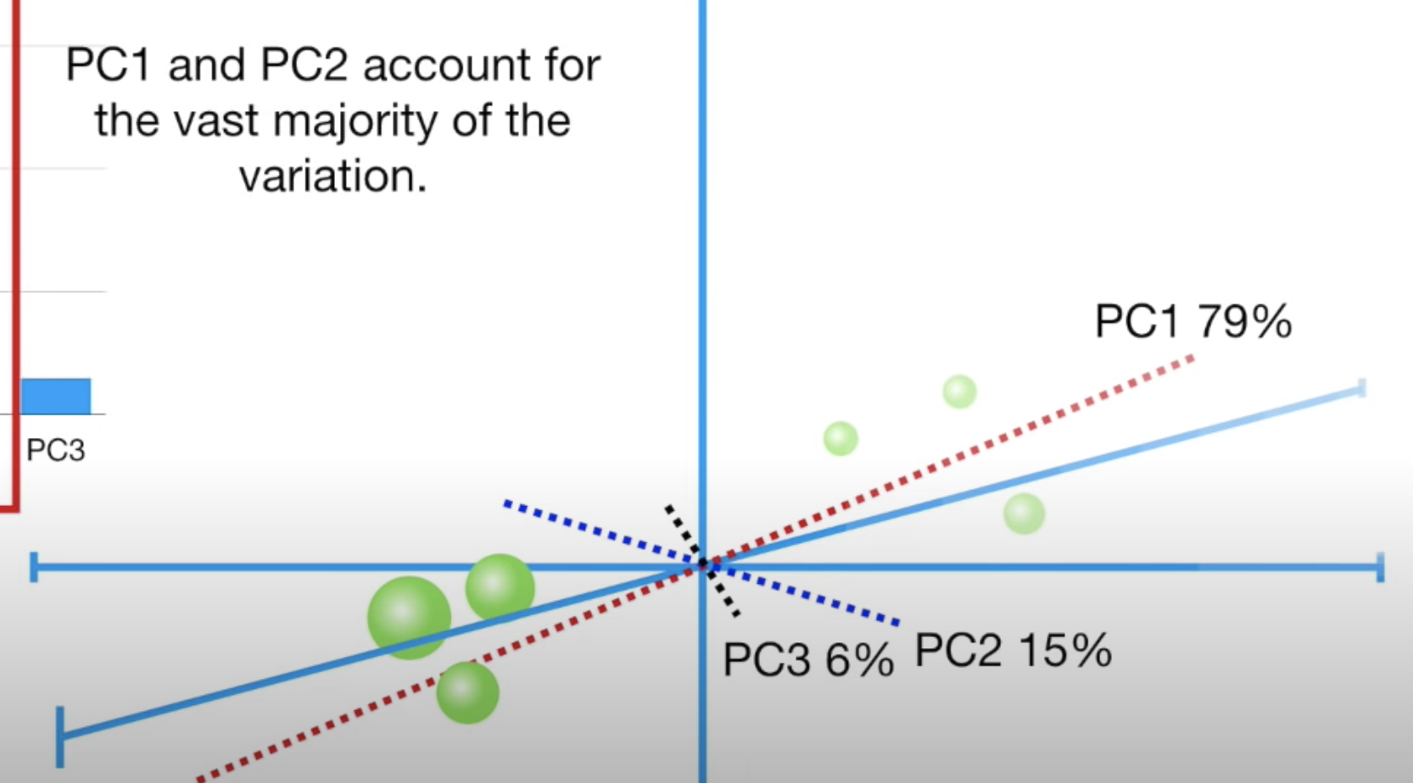

PCA - Details
The logic is still the same
Center the data
Find the best fitting line goes through the origin (PC1)
Find PC2 which is the best line that goes through the origin and perpendicular to the PC1
Find PC3 which is the best line that goes through the origin and perpendicular to the PC1 and PC2
So and so forth...
The number of PCs is the smaller of
The number of features and
The number of the samples

Slide 20
Incremental PCA
For datasets that are very large and cannot fit in memory, we can perform PCA incrementally in small batches, where each batch is able to fit in memory.
The batch size can be either set manually or determined automatically. When the batch parameter is None, then batch size will be min(n_samples, n_features).
The resulting principal components of PCA and incremental PCA are generally pretty similar.

Slide 21
Kernel PCA
Normal PCA, incremental PCA linearly project the original data onto a lower dimensional space, but there is also a nonlinear form of PCA known as kernel PCA, which runs a similarity function over pairs of original data points in order to perform nonlinear dimensionality reduction.
For the kernel PCA algorithm, we need to set
the number of components
the type of kernel
the kernel coefficient, which is known as the gamma.
The most popular kernel is the radial basis function kernel, more commonly referred to as the RBF kernel.

Slide 22
t-Distributed Stochastic Neighbor Embedding (t-SNE)
t-SNE is a nonlinear dimensionality reduction technique for visualizing high-dimensional data.
Modeling each high-dimensional point into a two- or three-dimensional space
Similar points are modeled close to each other
dissimilar points are modeled farther away
Uses two probability distributions
One over pairs of points in the high-dimensional space
Another over pairs of points in the low-dimensional space
Specifically, t-SNE minimizes the Kullback–Leibler divergence between the two probability distributions.

Slide 23
t-SNE - Important Notes
A practical tip
First apply PCA to get around 50 features from N features (N >> 50)
Then, apply t-SNE to get 2-3 features from 50 features
t-SNE has a nonconvex cost function, which means that different initializations of the algorithm will generate different results. There is no stable solution.

